Slide 1
How to Teach Computers to Recognize Things S3: Object Recognition: Building our Real-life “Textbooks”
Dr. Du Pengfei
CPPS/DMD
11 July 2024

Slide 2
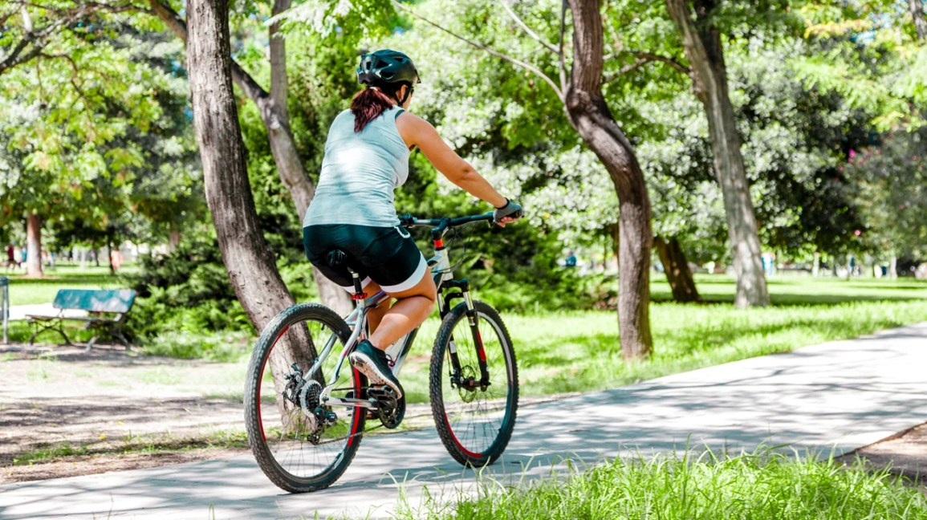
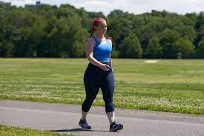
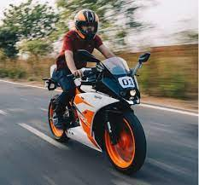
Transfer Learning: Connect knowledge in the Brain
Transfer learning (TL) is a research problem in machine learning (ML) that focuses on applying knowledge gained while solving one task to a related task.
Student A
Student B

Slide 3
Transfer Learning: Connect knowledge in the Brain
Transfer learning (TL) is a research problem in machine learning (ML) that focuses on applying knowledge gained while solving one task to a related task.
Pre-trained Models
From Scratch

Slide 4
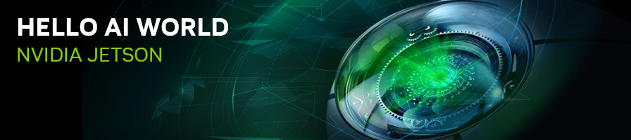
Running Applications
Popular Pre-trained Models to Try
https://github.com/dusty-nv/jetson-inference/blob/master/docs/aux-docker.md
Single-label Classification
Multiple-label Classification
Object Detection (Peoplenet, dashcamnet, etc.)
Pose estimation

Slide 5
Extension: Meet out Student: AI computers
Code Explanation:
cd jetson-inference
docker/run.sh
cd jetson-inference/build/aarch64/bin
./imagenet.py images/orange_0.jpg images/test/output_0.jpg
./imagenet.py --network=resnet-18 images/jellyfish.jpg images/test/output_jellyfish.jpg
./imagenet.py --network=resnet-18 jellyfish.mkv images/test/jellyfish_resnet18.mkv
./imagenet.py /dev/video0
./detectnet.py --network=ssd-mobilenet-v2 images/peds_0.jpg images/test/output.jpg
./detectnet.py /dev/video0
./segnet.py --network=<model> /dev/video0
./posenet.py --network=resnet18-hand /dev/video0
Notes:
https://www.youtube.com/watch?v=2hXG8v8p0KM

Slide 6
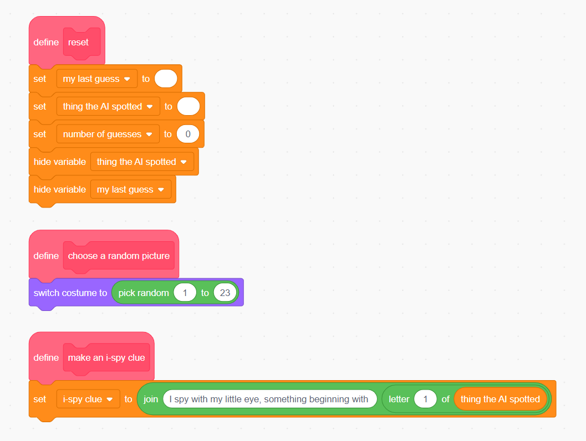
Extension: Meet out Student: AI computers
Notes:
https://www.youtube.com/watch?v=2hXG8v8p0KM

Slide 7
Contact: Du Pengfei
du_pengfei@SIMTech.a-star.edu.sg

